Slide 1


Prime Guide API Gateway Staging Solution Overview
Integration & API
for project-use
Version 2.0 | June 2024

Slide 2
Version History
Version | Date | Description
1.0 | November 2021 | Initial draft
1.1 | February 2022 | Document approved by PS Offer Lead
1.2 | June 2023 | Use of Artifactory now optional, new pipeline definitions, introduction of stages, description of drill-down failure analysis, description of alias value substitution
2.0 | June 2024 | Major overhaul covering the webMethods API Gateway Staging solution version 2.0 including the Azure DevOps Demo Generator

Slide 3
Agenda
1
webMethods API Gateway Staging Solution Overview
4
2
Implementation and Configuration
11
3
Alternative Approaches
29
4
References
33

Slide 4
Agenda
1
webMethods API Gateway Staging Solution Overview
4
2
Implementation and Configuration
11
3
Alternative Approaches
29
4
References
33

Slide 5
The webMethods API Gateway Staging Solution Offers Enterprise-Level, Production-Ready Management and Deployment of API Management Assets
All steps are fully automated with full auditing and roll-back capabilities
Deploy the right assets on the right targets in a controlled process
All API Management assets are managed in one place
Version control, single source of truth, branching, merging etc.
Export from BUILD Import on target
Individual build for each deployment unit and for each target:
Validate assets
Execute API tests
Prepare assets for target environment
Export
Import

Slide 6
All API Management Assets Are Managed in One Place
Main features
All assets for all stages are managed on one central API Gateway DESIGN environment
Visibility of assets in the DESIGN environment can be tailored using “Teams” feature
Optional: “Power users” can have their own (local) API Gateway instance for designing their API Management assets, they can use a provided CLI for importing and exporting of assets
Azure DevOps build pipelines for exporting API Management assets and committing them to Git
APIs and corresponding assets are grouped in “API projects” as clearly defined deployment units
API projects include assets for all target stages, for example applications for DEV, TEST and PROD stages
APIs can be marked as internal and/or external
These APIs will only be deployed on internal and/or external API Gateway instances
All assets can include placeholders in the form #{placeholder_name}#. They will be replaced by actual values during the build process
Optional: API DevOps build pipelines for automatically updating API specifications
This can be triggered by pipelines building the native (back-end) API

Slide 7
Version Control, Single Source of Truth, Branching, Merging etc.
Main features
All assets of an API project (for all target stages) are managed in one folder in Git
All Git/GitHub features like branching, tagging, comparing, merging, pull requests etc. can be used for establishing a professional software development life cycle for API Management assets
In addition to the API Management assets, every API project includes a Postman collection of test requests that are executed automatically during the build process
Optional: Every API project can include an aliases.json file in the repository specifying alias values for each alias and for each target environment (all alias types supported)
Optional: Every API project can include a scopes.json file with OAuth2 scopes (names and descriptions) for the local OAuth2 Authorization Server in API Gateway
Optional: API projects can be maintained in separate Git repositories for separate teams

Slide 8
Individual Build for Each Deployment Unit and for Each Target
Main features
Azure DevOps build pipelines for importing an API project on BUILD, executing validations and API tests, preparing the assets for the target environment, exporting them again from BUILD and importing them on the target environment
Optional: All APIs in the API project can automatically be republished to Developer Portal after deployment
Deployment will be aborted if any asset validation or API test fails
Placeholders will be replaced by target-specific values
Values can be managed in Azure DevOps variable groups
Confidential values can be managed as secret variables
Alias values will be replaced as per aliases.json file
OAuth2 scopes will be created as per scopes.json file
Optional: Build results can be stored in an artifact repository like JFrog Artifactory

Slide 9
Deploy the Right Assets on the Right Targets
Main features
Deployment unit will only include APIs marked as internal/external for deployment on internal/external API Gateway environments
Deployment unit will only include applications intended for the target stage
Deployment unit will not include any API with unwanted policies (e.g., local transaction logging)
API mocking is turned off for deployment on TEST and PROD target environments

Slide 10
Additional Features Available for all API Gateway Environments
Main features
Azure DevOps build pipelines for exporting and importing general API Gateway configuration items not bound to specific API projects (like default error processing, extended settings, destinations, ports, keystores, truststores, logging configuration, system settings, global policies, proxy server and proxy bypass settings, loadbalancer, local OAuth2 authorization server alias etc.)
Useful for setting up new API Gateway environments or for resetting existing environments to a defined state
Optional: Configuration of High Availability and Fault Tolerance (HAFT) solution
Azure DevOps build pipelines for purging analytics data
Can be scheduled to run automatically in regular intervals
Can be customized to implement different data retention policies

Slide 11
Agenda
1
webMethods API Gateway Staging Solution Overview
4
2
Implementation and Configuration
11
3
Alternative Approaches
29
4
References
33

Slide 12
Implementation and Configuration Overview
Main aspects
The solution can be applied to any set of API Gateway environments
Self-hosted on-prem or in private cloud (single instances or clusters)
webMethods.io API tenants (on Software AG cloud)
Even a mix of self-hosted and webMethods.io API tenants is also supported
Minimum set-up: DESIGN, BUILD, plus at least one target environment
API Gateway stages may consist of one or more environments
The solution will always keep the environments within one stage in sync
The solution is only using publicly available, documented and supported API Gateway REST APIs
All API Gateway REST API calls are implemented in Postman request collections
At runtime, the Postman collections are executed in Azure DevOps build pipelines using the Newman CLI tool for Postman
They can also be executed manually in Postman for testing and development
Exceptions: API project export and API Gateway configuration export is invoked directly using curl
The solution can be set up conveniently using a template for the Azure DevOps Demo Generator
The solution can be configured and extended in many ways, for example: New/updated/deleted API projects, API Gateway configuration items, API Gateway environments, stages and environment sets, pipelines implementing specific use cases, Postman collections implementing specific design-time policies

Slide 13
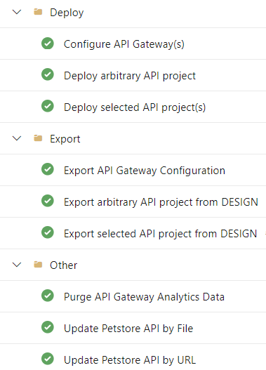
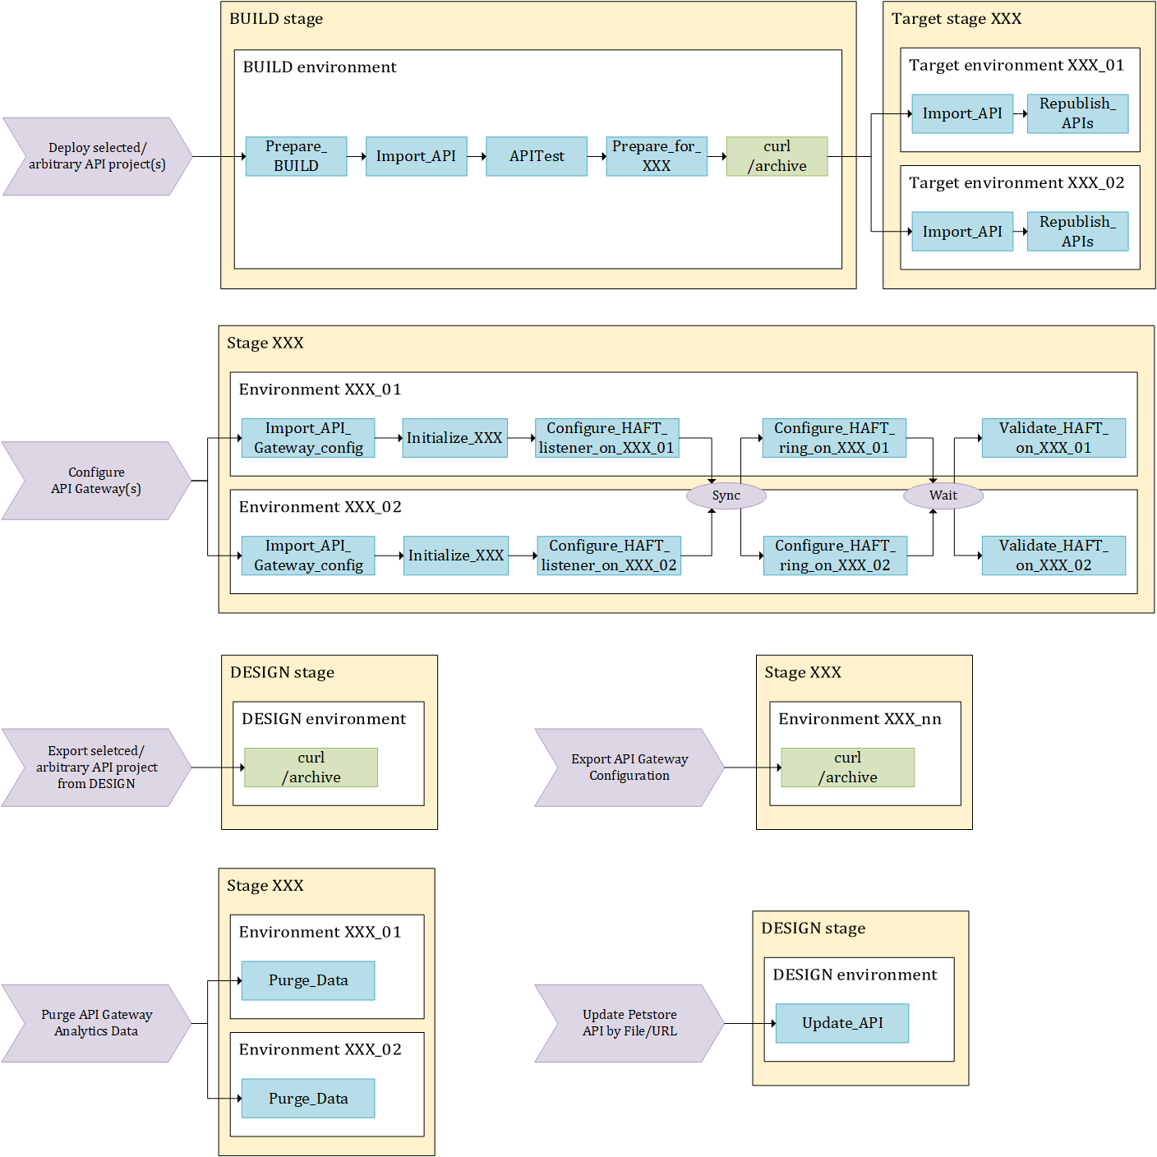
Azure DevOps Build Pipelines

Slide 14
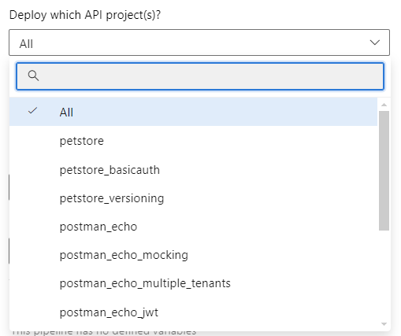
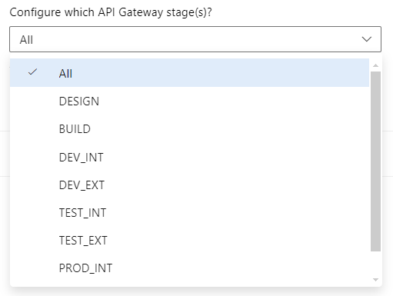
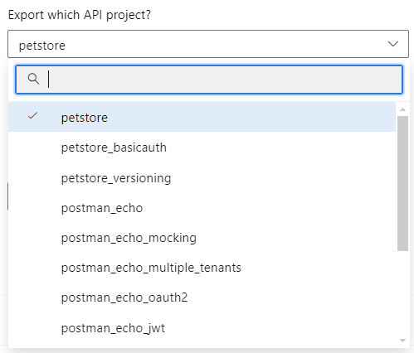
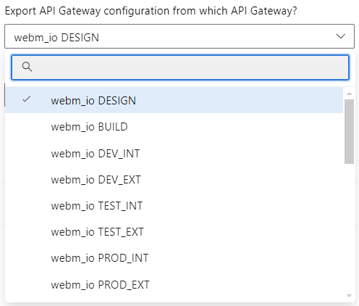
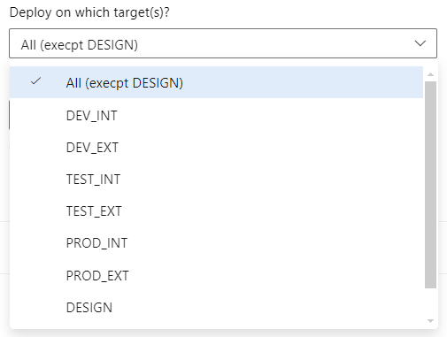

Azure DevOps Build Pipeline Parameters
API deployment
API Gateway configuration
API export
API Gw config export

Slide 15
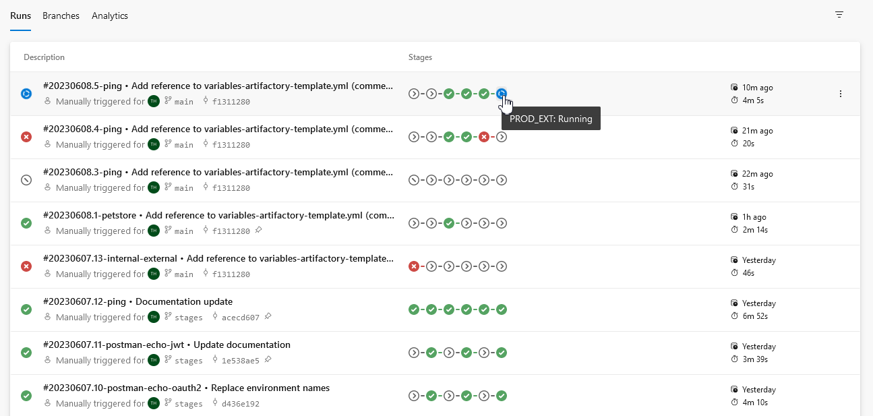
API Project Deployment Pipelines with Multiple Stages
Build results are organized by stages

Slide 16
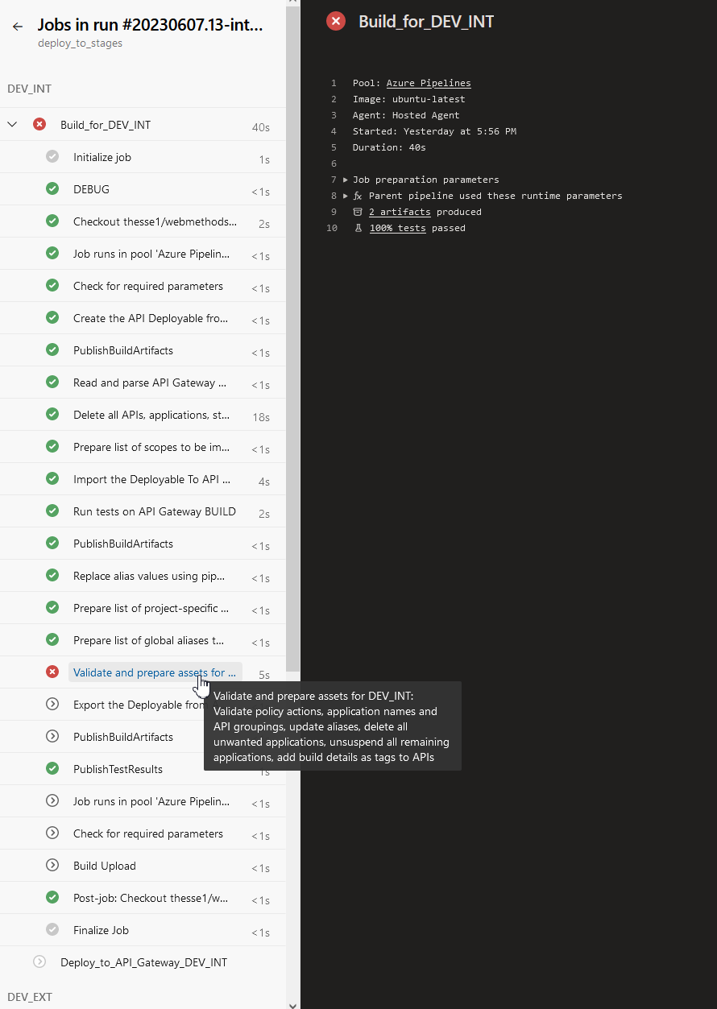
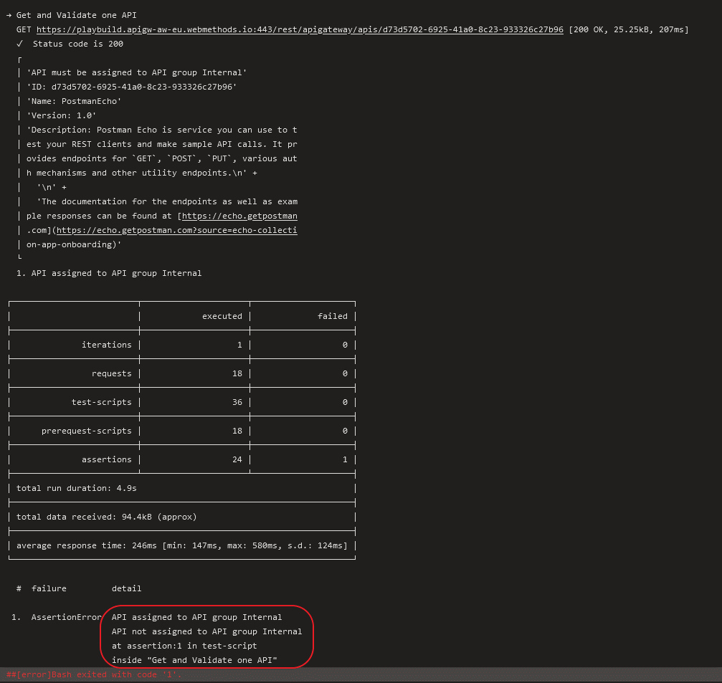
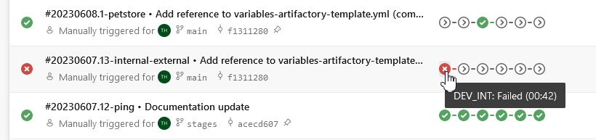
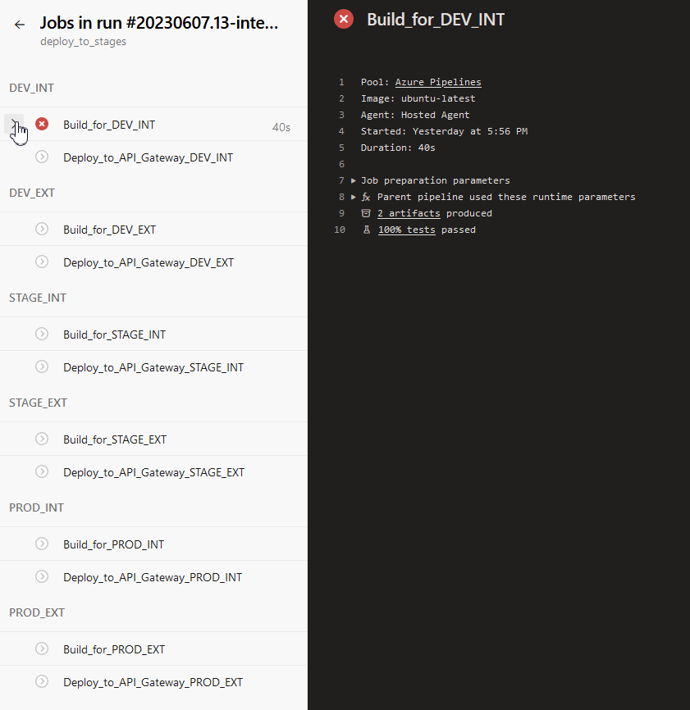
Azure DevOps Supports Drill-down to Analyze Deployment Failures

Slide 17
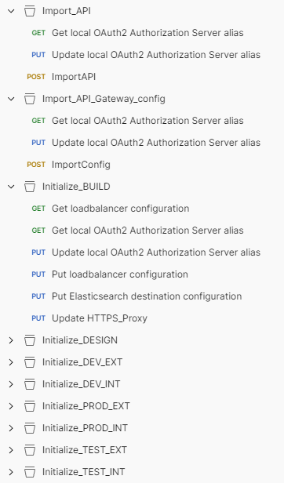
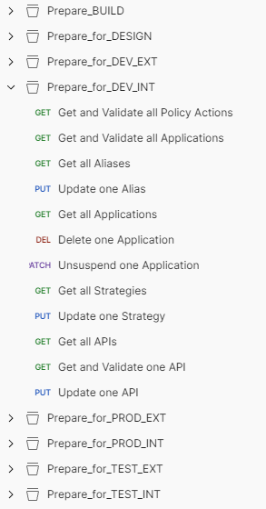
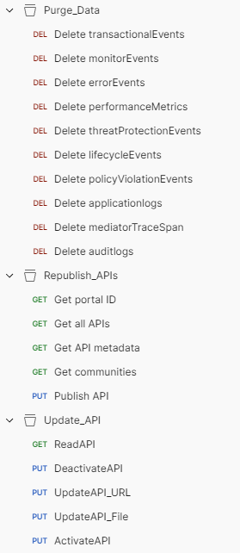
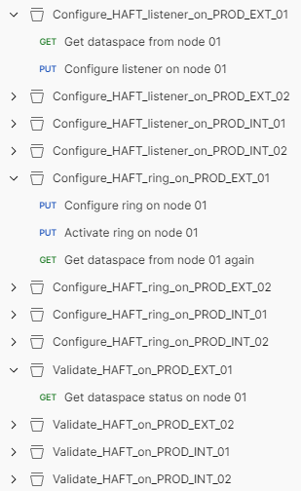
Major Steps are Defined as Postman Collections
Executed using Newman

Slide 18
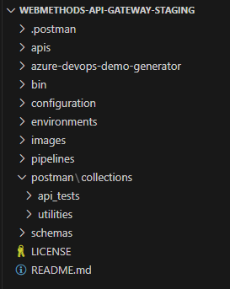
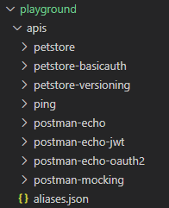
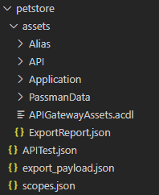
Grouping of APIs and Corresponding Assets in API Projects

Slide 19
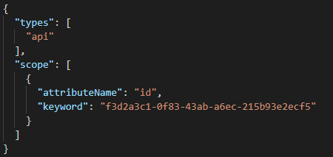
One Postman export_payload.json File per API Project
Defining the scope of the API project – query document for API Gateway Archive Service API
API project can contain one API or multiple APIs
All dependent assets will be included automatically
It might be necessary to add more assets to the API project scope in the export_payload.json file, for example OAuth2 scope mappings, users, groups, teams

Slide 20
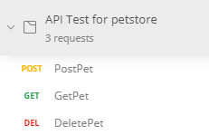
One Postman Collection with API-specific Tests per API Project
Executed using Newman
Test results can be inspected and consolidated in Azure DevOps

Slide 21

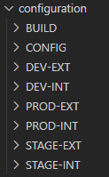
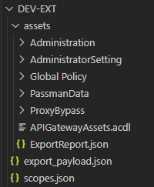
API Gateway Configurations per Stage
For setting up new API Gateway instances or for resetting existing instances to a defined state

Slide 22
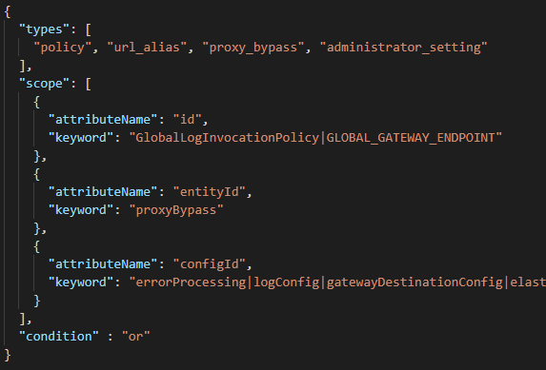
One Postman export_payload.json File per Stage
Defining the scope of the stage configuration – query document for API Gateway Archive Service API

Slide 23
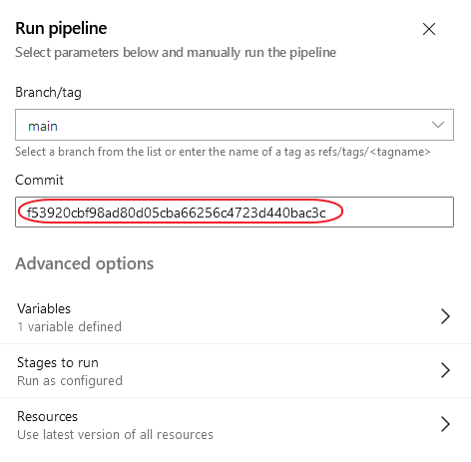
Everything Stored in a Git Repository (1/2)
Assets, API tests, API Gateway configurations, pipelines, Postman collections with utilities
Deployment and configuration pipelines can be executed for past development states by selecting a commit by its hash value

Slide 24
Everything Stored in a Git Repository (2/2)
Assets, API tests, API Gateway configurations, pipelines, Postman collections with utilities
Any changes in API assets or API Gateway configurations (or pipeline definitions!) can and should be committed into a feature branch
Deploy and test in DEV / STAGE
Develop new feature
Pull request
feature branch
main branch
Develop hot fix
Deploy in PROD
Merge changes

Slide 25
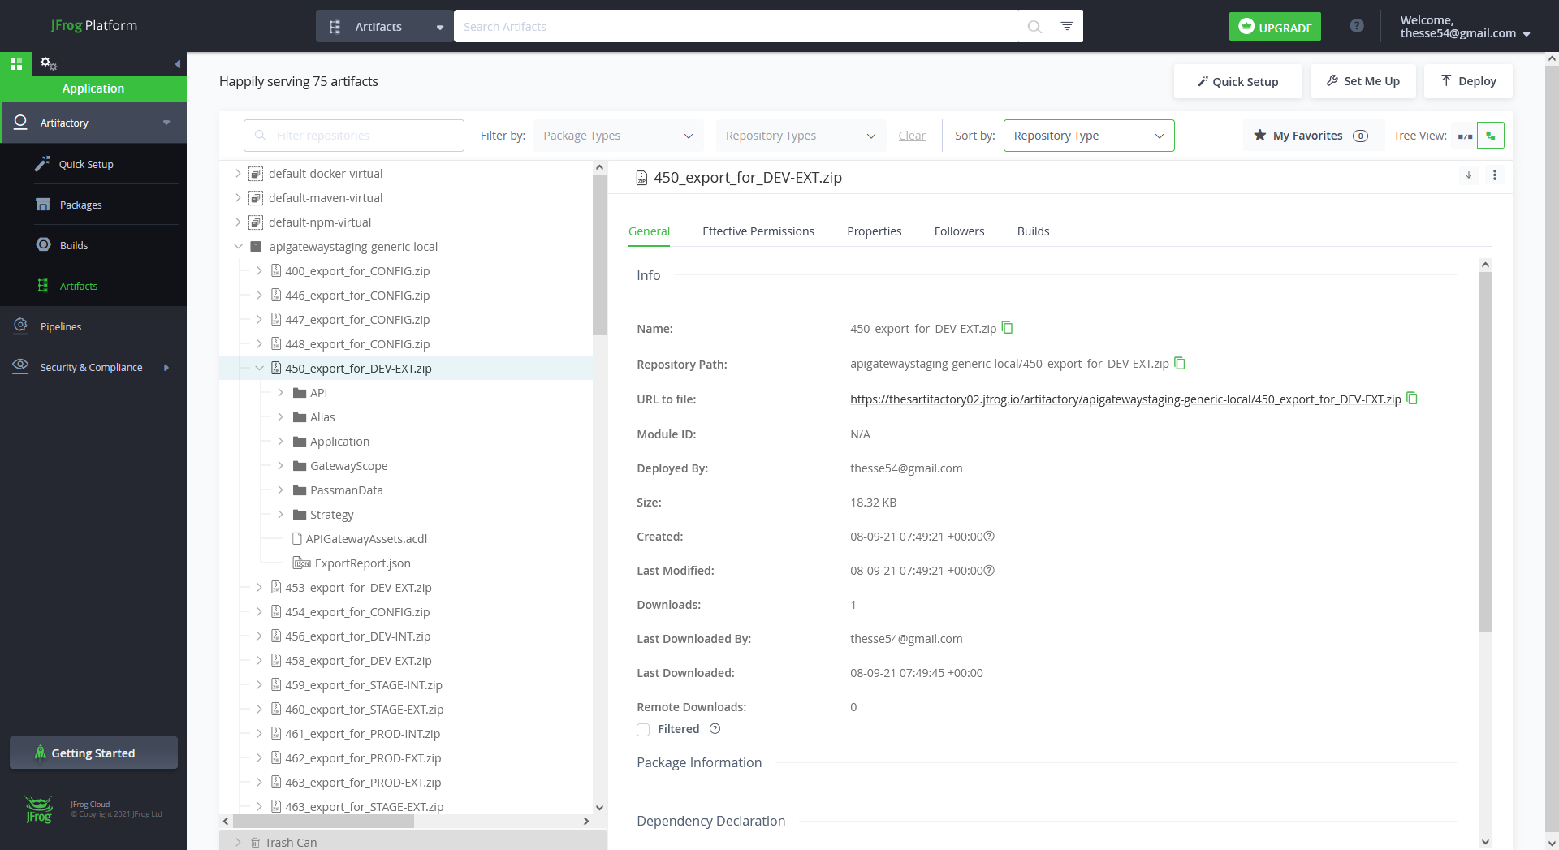
Build Results Can Be Stored in Artifactory
For a centralized overview of all assets deployed

Slide 26
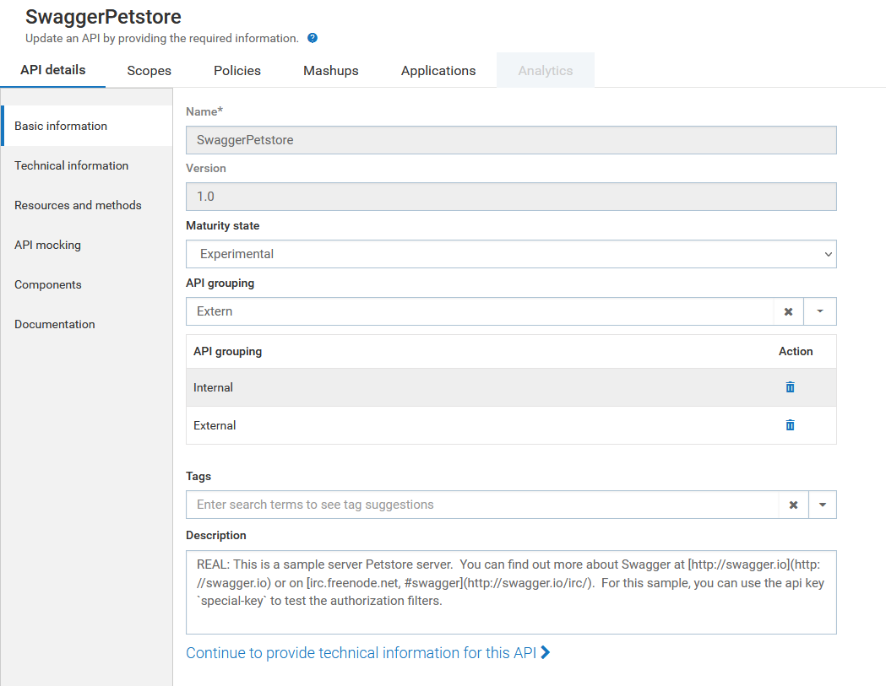
Mark APIs as Internal or External
Enforce deployment only on internal or external API Gateway instances
API can be deployed on DEV_INT, STAGE_INT and PROD_INT
API can be deployed on DEV_EXT, STAGE_EXT and PROD_EXT

Slide 27
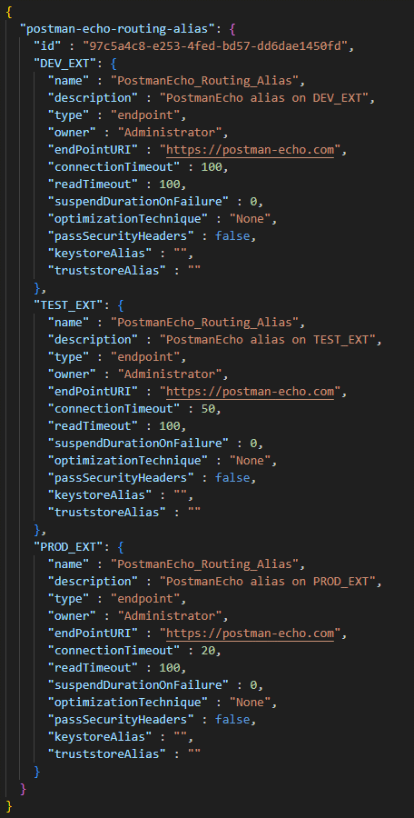
Management of Alias Values Across Stages – All in One Place
Based on aliases.json repository files
Alias configuration for DEV_EXT
Alias configuration for TEST_EXT
Alias configuration for PROD_EXT

Slide 28
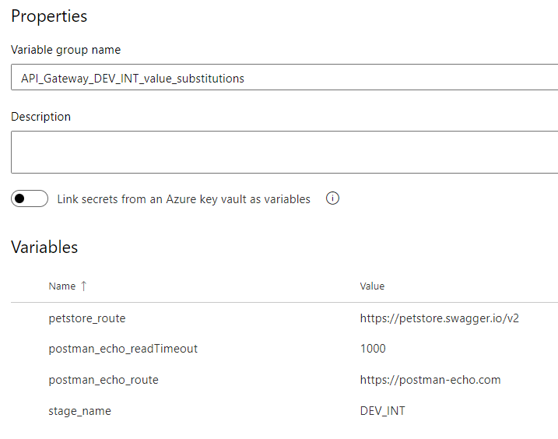
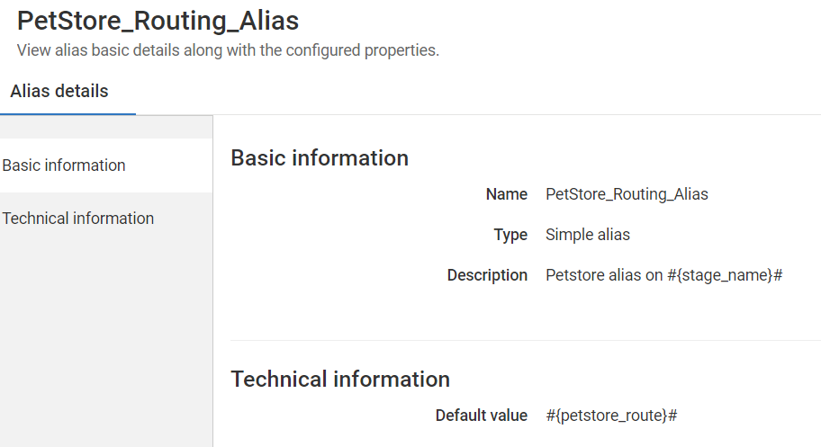
Placeholder Values Can Be Overwritten Using Pipeline Variables
Allows for ad-hoc, per-deployment stage-specific alias values
Azure DevOps pipeline variable group
API Gateway alias with placeholders

Slide 29
Agenda
1
webMethods API Gateway Staging Solution Overview
4
2
Implementation and Configuration
11
3
Alternative Approaches
29
4
References
33

Slide 30
Three Alternative Options for API Gateway Staging
Good solutions for simple use cases, but lacking flexibility for enterprise customers
Export and Import
Export assets from source environment
Import assets on target environment
Can be executed manually in the API Gateway UI itself or through the API Gateway REST API
Export archive will automatically include all dependent assets (hard dependencies)
Stage-specific alias values not supported
Promotion Management
Direct promotion from one instance (or cluster) to another instance (or cluster)
Can be executed manually in the API Gateway UI itself or through the API Gateway REST API
Automatically promotes all dependent assets (hard dependencies)
Stage-specific alias values supported for all alias types
Asset Staging using Asset Build Environment and Deployer
Asset staging through additional tools: Asset Build Environment (ABE) and webMethods Deployer
Configuration and execution outside of API Gateway
Can be fully automated
Staging will always include all dependent assets (hard dependencies)
Stage-specific alias values supported for all alias types
All three options are based on the assumption that the assets should be moved unchanged from source environment to target environment (with the exception of alias values)
But in reality, many customers are asking for changes to be applied automatically when assets are moved from one stage to the next stage -> asset manipulations

Slide 31
Common Requirement: Asset Manipulation During Staging
Some examples (real-world use cases)
Change alias values on the fly
Change set of registered applications for an API
Change identifiers for applications
Activate/deactivate applications
Turn API mocking on/off
Add/remove/change API policies, e.g., different authentication policies or different log levels per stage
Add API tags for identifying deployment

Slide 32
Common Requirement: Asset Manipulation During Staging
Possible approaches for this requirement
Apply manipulation on the assets in the export archive
not supported, does not work (only for very small manipulations), ACDL
Apply manipulation on source environment before export and revert change after export
small timeslot with incorrect configuration on source environment (after manipulation, before reverting)
too risky, what if it fails?
Apply manipulation on target environment after import
small timeslot with incorrect configuration on target environment (after import, before manipulation)
even more risky, what if it fails?
Execute manipulations on a dedicated build environment:
Export from source environment
Clean build environment
Import on build environment
Execute manipulations (and validations and tests)
Export from build environment
Import on target environment
This approach was implemented in the API Gateway Staging solution

Slide 33
Agenda
1
webMethods API Gateway Staging Solution Overview
4
2
Implementation and Configuration
11
3
Alternative Approaches
29
4
References
33

Slide 34
API Gateway Staging Solution
References
Code and documentation can be found in GitHub: https://github.com/thesse1/webmethods-api-gateway-staging
PRIME Guide: API Gateway Staging Solution Set-up
Introduction with online demo: PS DACH & Bulgaria Community Webcast
Possible alternatives for the automated initial configuration of API Gateway instances:
https://github.com/SoftwareAG/webmethods-api-gateway-ansible
https://github.com/SoftwareAG/sagdevops-ansible-roles
https://www.youtube.com/watch?v=a4Q4-MBPOA8

